Slide 1
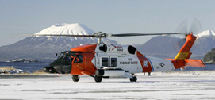
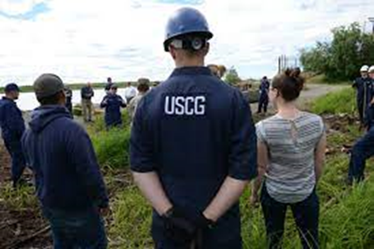
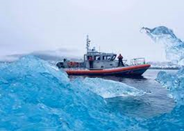
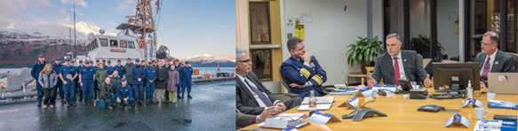
ADAC Year 8 Annual Meeting
...Via Conference Call, 20-21 April 2022
ADAC Center Overview of Projects
Briefing
Jeff L. Libby, Executive Director, University of Alaska Anchorage
Heather L Paulsen, Finance Director, University of Alaska Anchorage

Slide 2
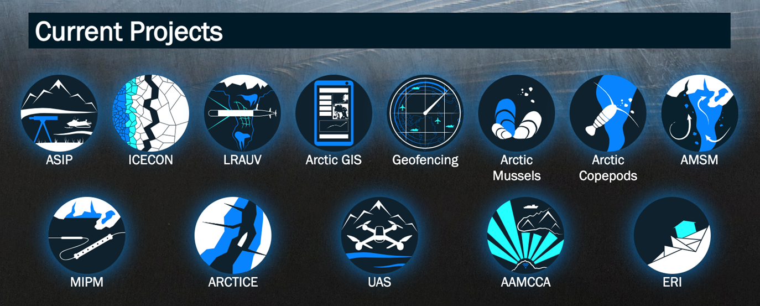
ADAC’s S&T Research Projects
ADAC Program Year 8 Annual Meeting

Slide 3
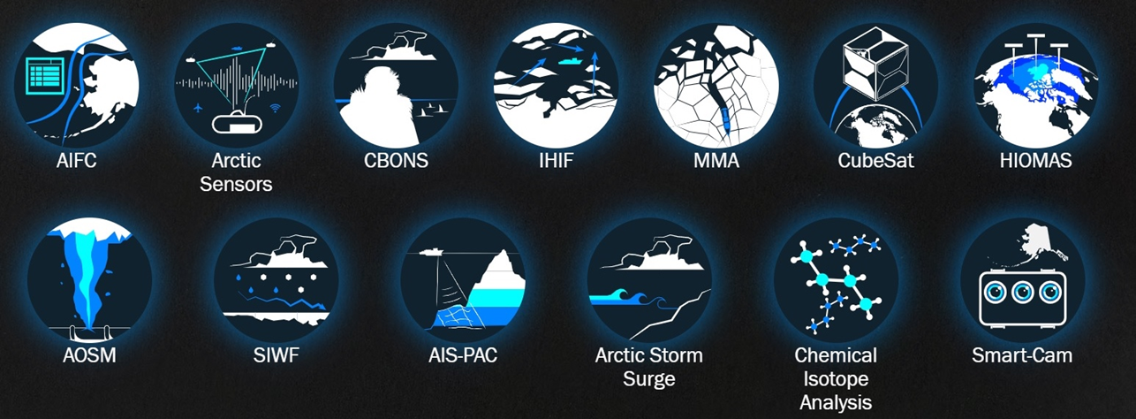
ADAC’s Completed S&T Research Projects
ADAC Program Year 8 Annual Meeting

Slide 4
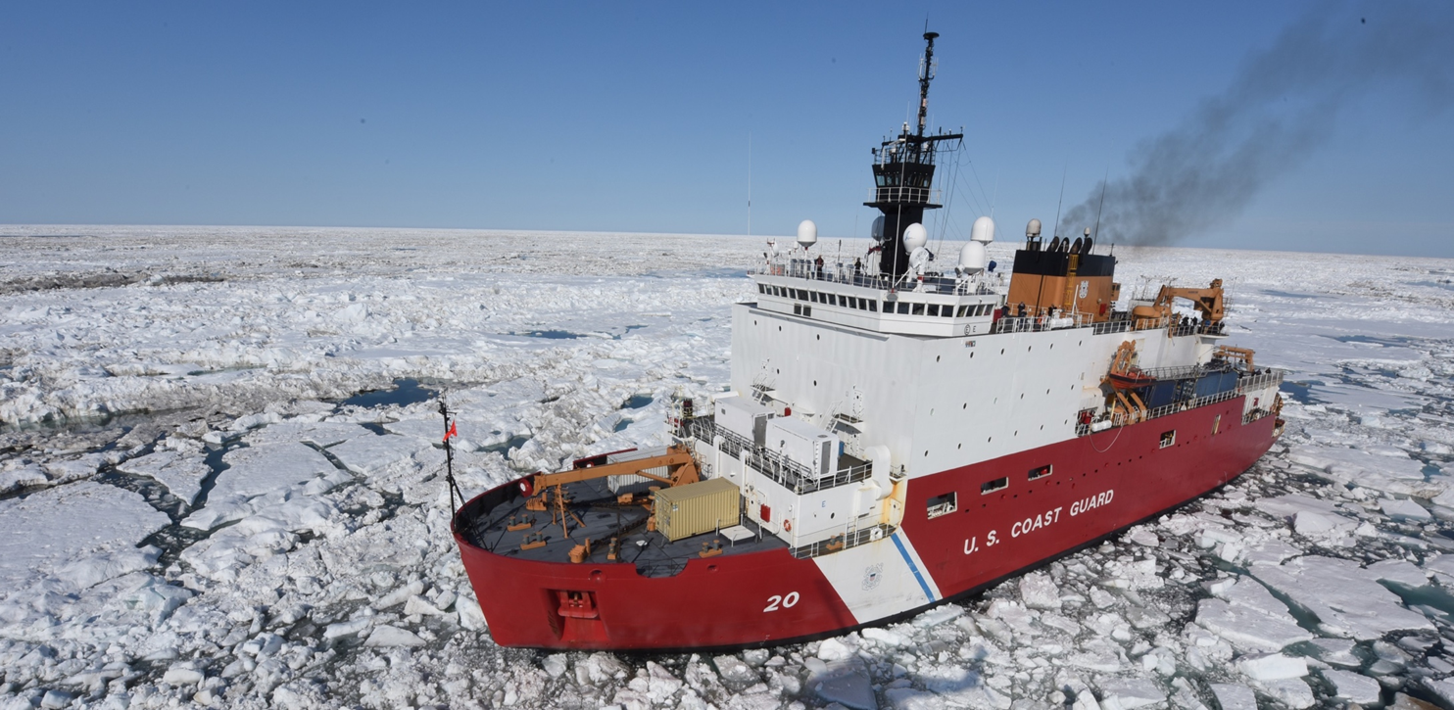
ADAC Project Summary Details
ADAC Program Year 8 Annual Meeting

Slide 5
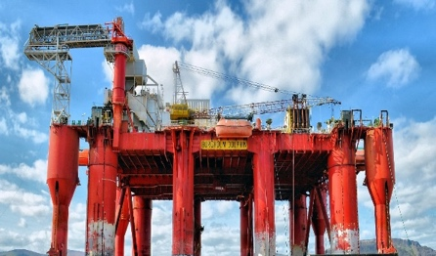
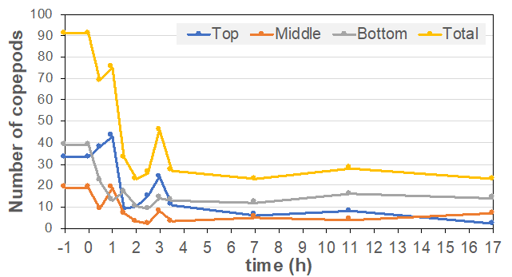
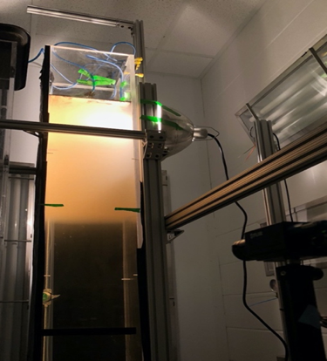
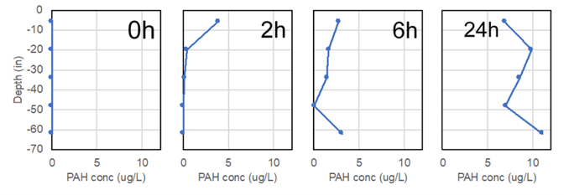
Mitigating the Damage to Arctic Copepods from Surface Oil Spills: When to Apply Dispersants
ADAC Program Year 8 Annual Meeting
Project Description:
Copepods are tiny oceanic crustaceans that not only occupy an extremely vital niche in ecological food chains, but can serve a role as biodiversity indicators as well. This project’s goal is to determine if Arctic Calanus copepods can spatially separate themselves from surface oil spills during portions of their developmental cycle. The primary benefit to stakeholders is a greater understanding of how oil spills and dispersants impact copepods.
Project deliverables/Transition:
Technical reports with all results of the research, delivered to USCG and DHS.
Three peer-reviewed publications, addressing each of the phases and objectives individually.
Make all data produced during this project publicly available at the Knowledge Network for Bio-Complexity data repository.
FOSC Crisis Response Guide
Phase 1:
Determine whether C. finmarchicus copepods actively avoid oil or dispersants
Phase 2:
Investigate dispersant influence on subsurface wildlife exposure to oil products
Phase 3:
Determine how water column stratification and light affect contact between copepods and oil
An example of PAH concentrations (ug/L) over depth (in), 0 hr., 2 hr., 6 hr., and 24 hr. after introduction of fresh crude oil (ANS).

Slide 6
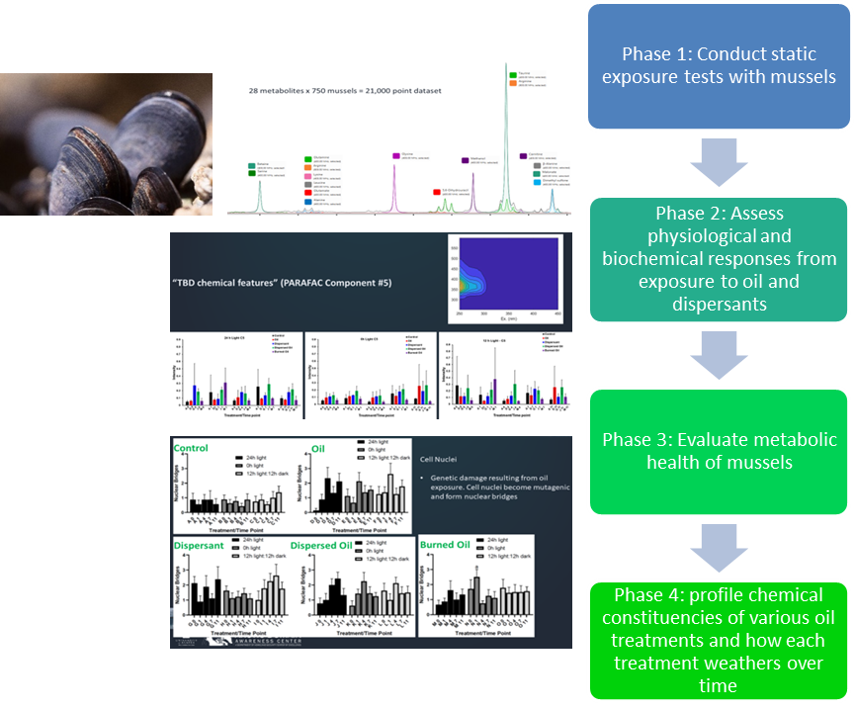
Photo-enhanced toxicity of dispersed and burned Crude Oil to Arctic Mussels
ADAC Program Year 8 Annual Meeting
Project goal:
To determine whether dispersants or in-situ burning has a greater effect on Arctic mussel toxicity, and whether extreme seasonal differences in sunlight affect acute sublethal response.
Project deliverables:
Knowledge product publishing the research conducted, analysis, conclusions and recommendations.
The published works will also include peer-reviewed scientific article(s)
Researchers will create a weighted Pugh concept selection matrix. Project personnel will perform concept selection and identify relative criteria weights.
Transition: Knowledge Products for USCG and Publications to Peer Review Journals supporting Oil Spill Research. New Summary Guide as well for FOSC in crisis response

Slide 7
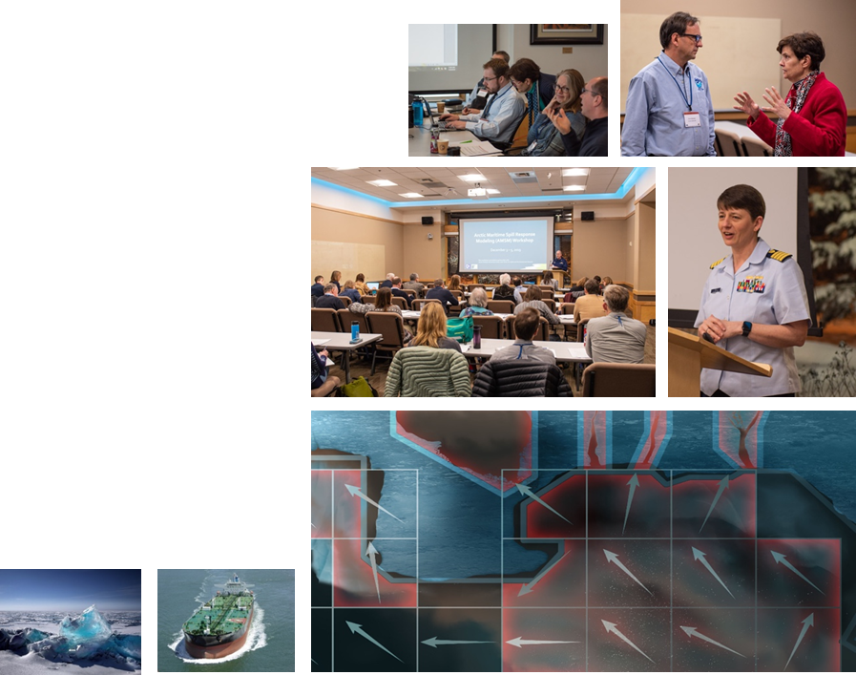
Oil Spill Modeling for Improved Response to Arctic Maritime Spills: The Path Forward
ADAC Program Year 8 Annual Meeting
ADAC’s research seeks to provide practical solutions for operators. Scientific research sometimes provides divergent solutions – i.e., using one specific approach to examine the effects on an overall system.
The goal of this project is to provide a path forward to improving Arctic oil spill response models by using convergent solutions – how to improve an overall system by potentially incorporating multiple approaches.
Project uses workshops and working groups of cross functional experts in oil spill modeling.
Project deliverables/Transition:
This project will result in a knowledge product describing:
1. Specific needs and questions that must be addressed by Arctic oil spill response models;
2. Current state-of-the-art Arctic oil spill models available;
3. State-of-the-art Arctic oil spill response model utility in response modeling;
4. Components from recent research efforts (e.g., Gulf of Mexico Research Initiative (GOMRI) useful for incorporation in order to improve current Arctic spill response models.

Slide 8
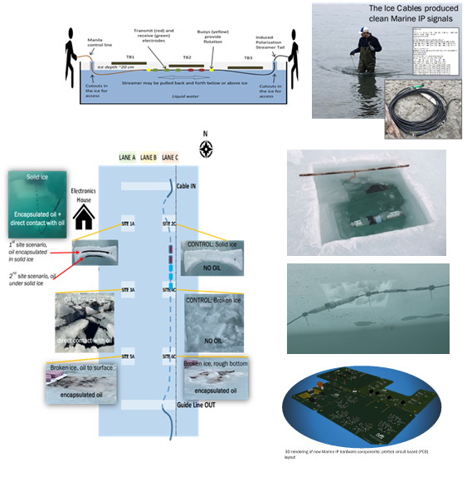
Marine Induced Polarization Methods for the Detection and Mapping of Oil in an Arctic Marine Oil Spill; Including Investigation of Oil Within and Under Broken Ice Fields
ADAC Program Year 8 Annual Meeting
Marine Induced Polarization (IP) is a USGS-patented technology that takes advantage of material properties to sense subsurface materials, such as oil trapped in ice.
In IP, a voltage is adsorbed (adhered to the surface of a material) through electrodes placed in the ground.
A different set of electrodes measures subsurface electric resistance and capacitance. All materials have unique resistive and capacitive properties.
Measuring subsurface capacitance and resistance enables identification of possible subsurface materials.
Detecting location of trapped oil within or under broken ice fields greatly improves Federal On-Scene Coordinator decision-making capability.
Planned research seeks to understand the ability of Marine IP to characterize the nature and mapping of Arctic oil spills, thereby honing ability to conduct effective oil spill responses.
Project deliverables/Transition:
The outcome of this research will be
A series of knowledge products (technical reports and supporting data) that may demonstrate Marine IP technology can be effectively utilized in the Arctic environment.
Marine Ready IP Kit as a prototype for rapid use in a crisis response spill

Slide 9
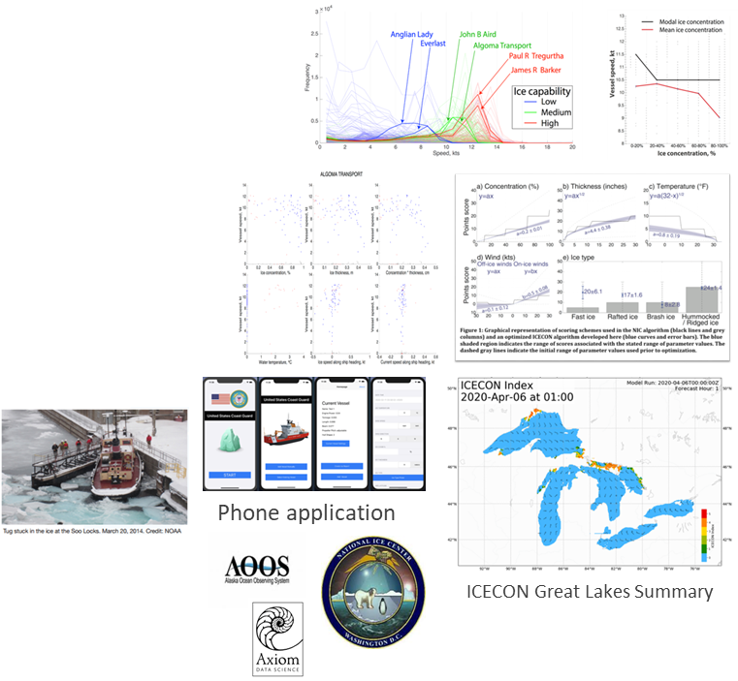
Ice Conditions Decision Index for the Great Lakes region
ADAC Program Year 8 Annual Meeting
Project Goal:
ADAC researchers are finalizing an ice condition index (ICECON) for the Great Lakes for USCG operators and lake mariners, which uses available data to forecast ICECON up to 3 days into the future. This enhances ship safety, potentially reducing number of icebreaker deployments for rescuing vessels entrapped in ice.
With ice parameters collected by USCG and Canadian Coast Guard crews operating in the Great Lakes in the 2016-2020 time frame, the team has advanced Monte Carlo simulations to determine the most predictive relationship between the ice parameters and ICECON.
The team is also using ice data from the 2013-2020 period in conjunction with AIS data to determine which parameters affect vessel speed and are important to ICECON.
Researchers continue to pull nowcast and forecast data in real-time (every 6 hours), compute the ICECON nowcast and forecast, and display it on a project website…currently using Canadian Ice Services Environmental data.
Transition: USNIC projects ICECON Via AOOS & Axiom Data Science Computation.

Slide 10
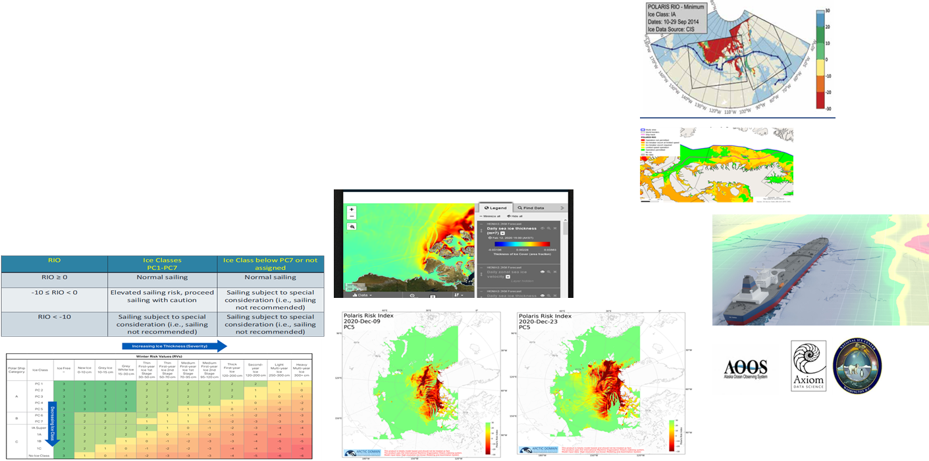
Arctic Ice Condition Index (ARCTICE)
ADAC Program Year 8 Annual Meeting
Project Description: ARCTICE produces an easy-to-understand numeral to communicate ice conditions that are relevant to the capabilities of an individual vessel. This index will be available for current and future ice conditions, providing forecasts up to 72 hours in advance. Based on prior Great Lakes ICECON investigations, research will provide marine operators a transition destination ready access to this information (such as the U.S. National Ice Center...USNIC) supporting vessel captains in route planning and determining associated risk with traveling through a particular region in Arctic Waters.
Broad area, low resolution idealized chart for ARCTICE output
High resolution/low area idealized chart for ARCTICE output
Currently leveraging HIOMAS for environmental factors

Slide 11
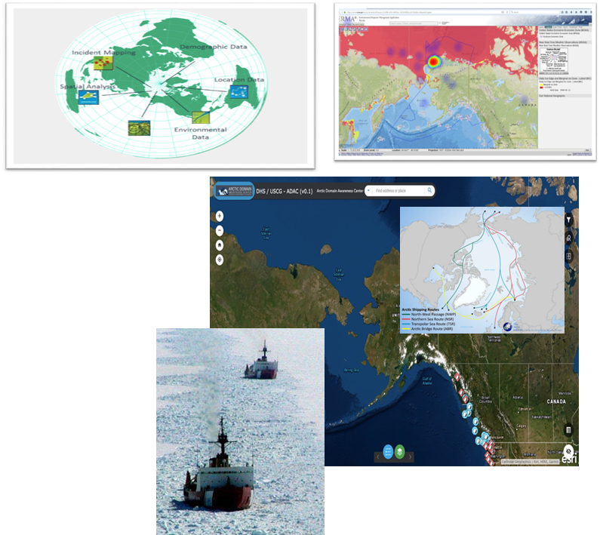
Arctic Domain All-Hazards WebGIS
ADAC Program Year 8 Annual Meeting
Project goal:
To assist and enhance U.S. Coast Guard domain awareness by developing an Arctic All-Hazards webGIS product built within the DHS Geospatial Information Infrastructure and the Homeland Security Information Network.
The All-Hazards project seeks to improve usability, interoperability, and function by developing the webGIS geo-visualization product.
Project phases:
Phase 1: Interviewing, survey and research brief
Phase 2: Data acquisition and development of web application
Phase 3: Alpha Release
Phase 4: Beta Release and user guide
Phase 5: Go Live and Final Delivery
Phase 6: Final Usability Report
Phase 7: Submit peer-reviewed publication
Transition: Test application with USCG uniformed and civilian staff during alpha and beta testing, then house Arctic All-Hazards WebGIS within the GII/HSIN.

Slide 12
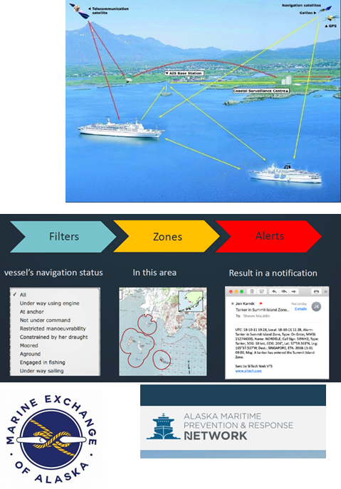
Arctic Vessel Monitoring Geofencing/ Alert Awareness
ADAC Program Year 8 Annual Meeting
Advance Arctic Maritime Domain Awareness and Management by boosting the development and implementation of automated geofencing alerts to the U.S. Coast Guard to enhance maritime safety, security, environmental protection, and vessel regulatory compliance in U.S. Arctic Waters.
Two prong effort: 1. PACTRACS (for commercial mariner community) via Alaska Marine Exchange 2. USCG “CGOneView” for USCG operational watch standers
Geofences can be customized by the end-user to meet agencies requirements.
Have multiple filters and GIS overlays to better discriminate vessel type and activities.
GIS files importable and exportable by end-users.
Alerts and notifications can be received on multiple unclassified platform devices by government agencies.
Geofence/alert notifications sent to Social Media/email platforms for other Federal/State agencies and Arctic stakeholders.
Coastal Communities receive tailored notification and alerts.
Supports: U.S. Coast Guard, State of Alaska, and the maritime industry within the U.S. Arctic Exclusive Economic Zone
Transition: PACTRACS version completed and mid-way for developing CGOneView edition in coordination with HQ USCG.

Slide 13
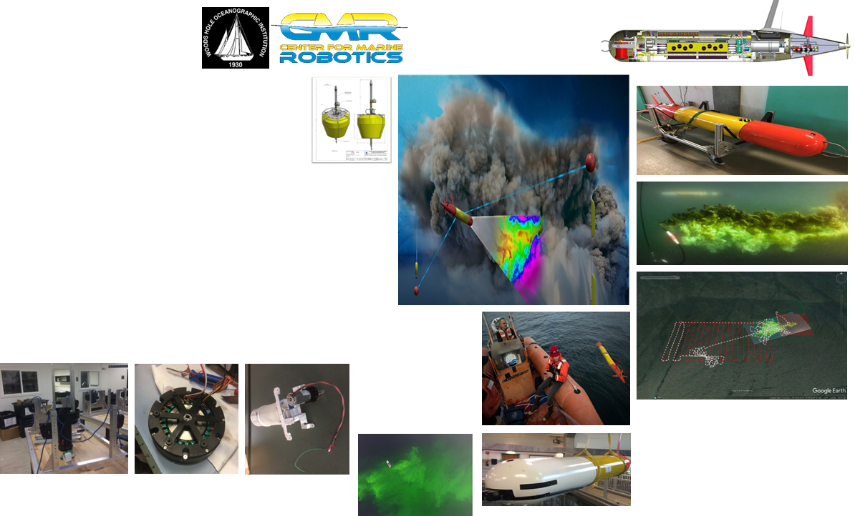
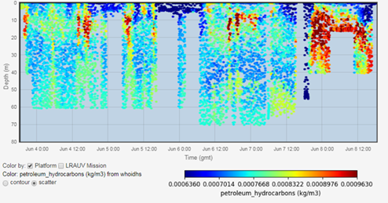
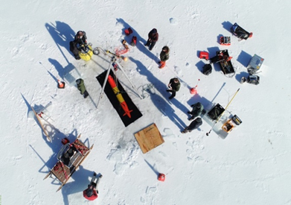
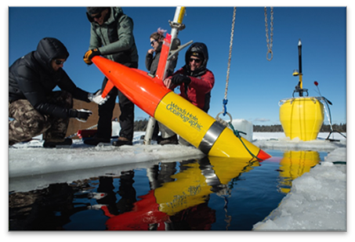
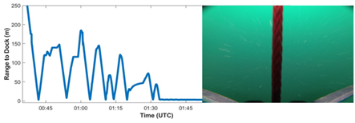
Propeller Driven Long Range Autonomous Underwater Vehicle
ADAC Program Year 8 Annual Meeting
Project Description:
LRAUV is helicopter portable, carrying an environmental mapping payload which allows rapid response to provide situational awareness and damage mitigation for first responders/USCG.
Initial Capabilities (expandable):
Ability to map in 3D.
Extended unattended deployment (days to weeks).
600 KM range…under ice.
Detection and quantification of dissolved particles and fluorescent material (with current sensor package).
Environmental characterization.
Transition: CG-926, USCG RDC & or Commercialization.

Slide 14
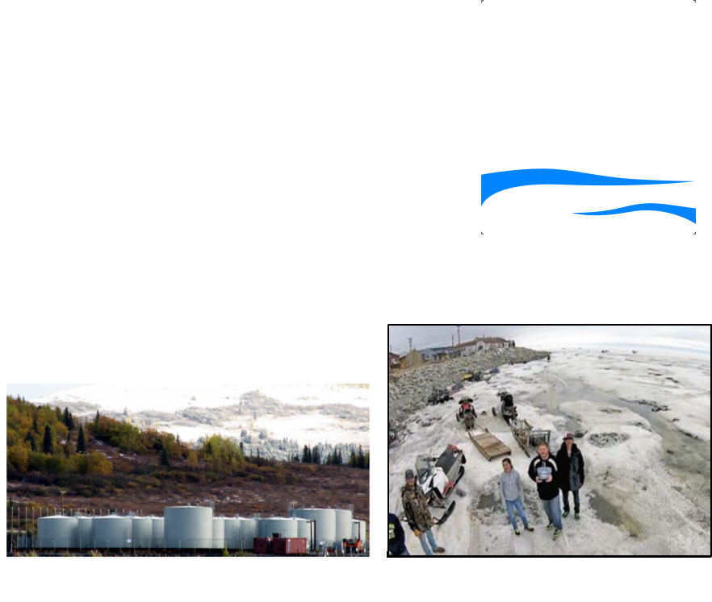
Remote Unmanned Aircraft System (UAS) Inspection and Response Team Development in the Bering Strait Region
ADAC Program Year 8 Annual Meeting
This program will develop a trained pilot team (planned at five individuals) within the community of Unalakleet, versed in the operation of off-the-shelf U.S. made UAS technologies.
    Project goals:
Create a knowledge product providing analysis of experiments using multispectral sensor capacity to support infrastructure monitoring
Co-produce a UAS-based monitoring program focused on USCG regulated bulk fuel facility inspections and emergency response, with the Alaska Native Village of Unalakleet
Understand the feasibility of expanding the developed monitoring program to communities throughout the Norton Sound region to effectively support CG facility inspections and the response efforts in remote western Alaska
Determine if this project can be used as a roadmap for that expansion

Slide 15
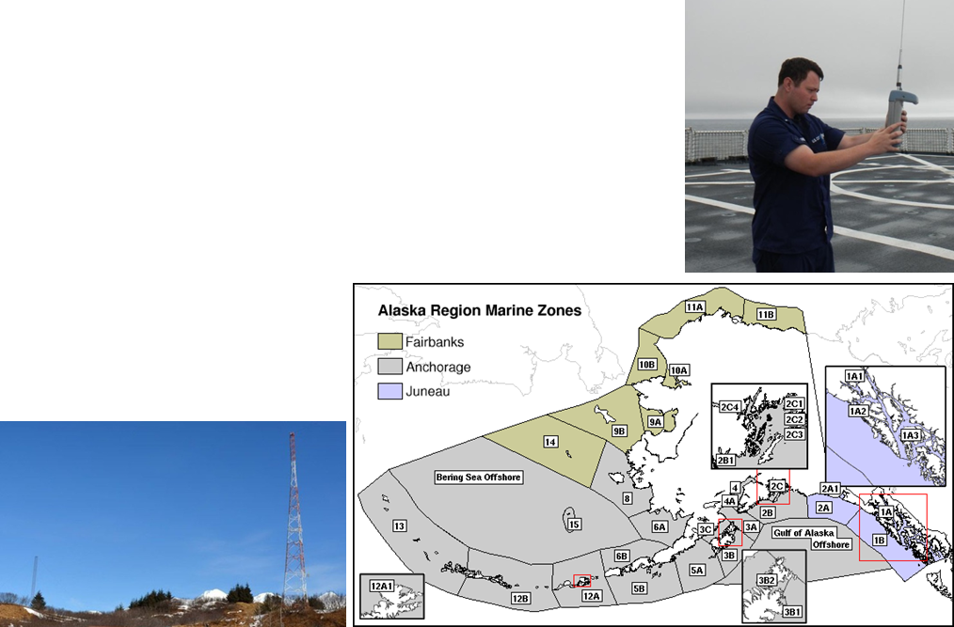
Alaska and Arctic Maritime Communications and Connectivity Analysis (AAMC&CA)
ADAC Program Year 8 Annual Meeting
Project Description: This project provides a comprehensive review of mariner communications and connectivity mission needs for the Alaska and the U.S. Arctic Extended Economic Zone (EEZ), with a particular focus on the Arctic (based on near, mid-term, and long-term time horizons)
The knowledge product will contain:
Comprehensive review of mariner communications and connectivity needs for the Alaska and the U.S. Arctic Extended Economic Zone (EEZ)
An updated and expanded market survey current communications technology
A geographic review of communications/ connectivity shortfalls
A technology-focused review of known/understood existing capabilities, assessed against researched gaps for the high latitudes
An expert-derived set of options and recommendations

Slide 16
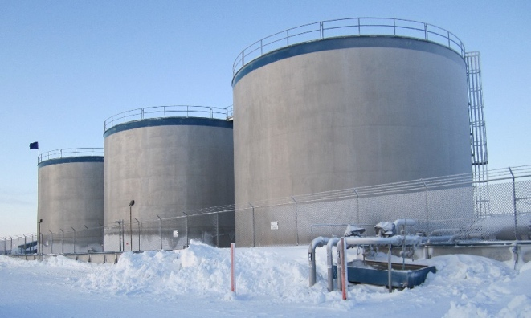
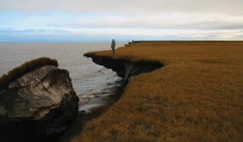
Arctic Facilities and Infrastructure Environmental Change Index
ADAC Program Year 8 Annual Meeting
This project provides the U.S. Coast Guard an “Arctic facilities and infrastructure environmental change” risk index, training guide, and comprehensive knowledge product to inform U.S. Coast Guard operations and inspections in order to manage inspection and response decision risk in a rapidly changing Arctic environment.
Objective/Purpose.
This project will address direct concerns regarding structural risks of facilities and infrastructure in Arctic Alaska due to cumulative effects of environmental change.
Based upon analyzing these concerns, this research will address two principal questions:
What are the risks and severity to USCG monitored facilities along the Arctic coastal regions of the Bering, Chukchi and Beaufort Seas?
What are the risk weightings related to the USCG monitored facilities along the Arctic coastal regions?
Drew Point, Alaska Photo from USCG.gov
Bonanza Fuels, Nome, Alaska Photo from AIDEA.org
Project outcomes for the research:
Synthesize published literature, existing data from available sources, USCG infrastructure and incident reporting, and consolidate expert opinion to establish a baseline knowledge project in support of USCG Project Champion and USCG Project stakeholders. This information will guide and inform the project’s interdisciplinary workshops and focused working groups Examples provided: Alaska District U.S. Army Corps of Engineers, State of Alaska Department of Environmental Conservation, Denali Commission, University of Alaska Fairbanks Institute of Northern Engineering, Associated State of Alaska Boroughs, Ports and Villages associated with USCG designated infrastructure and facilities of concern and others as determined by the research team and established project research groups.

Slide 17
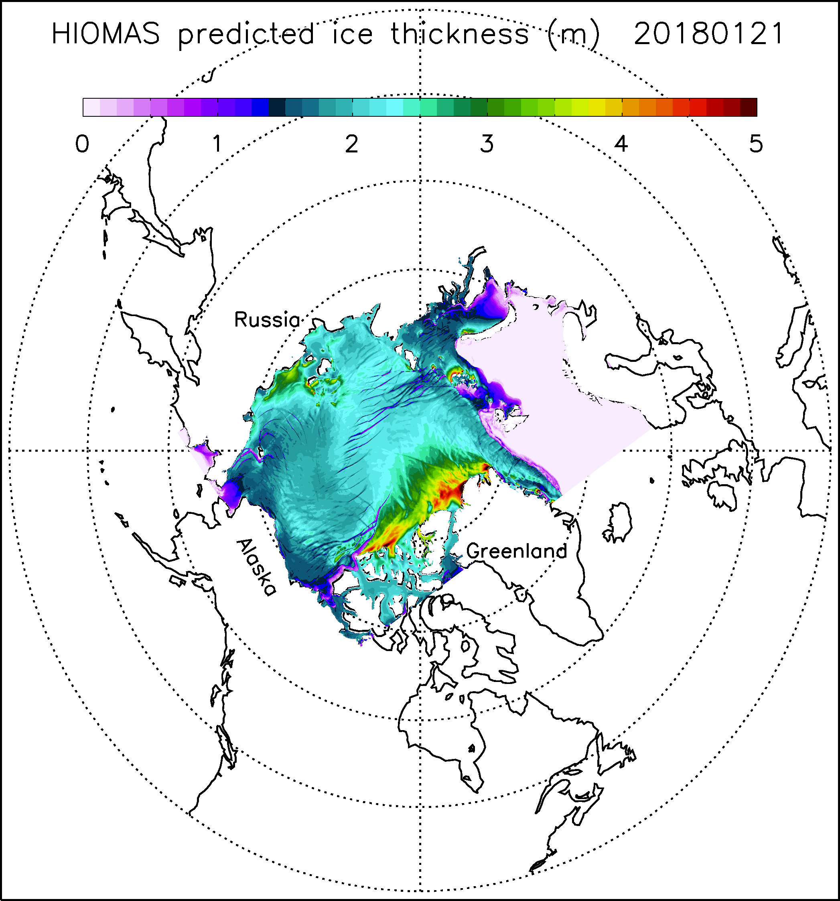
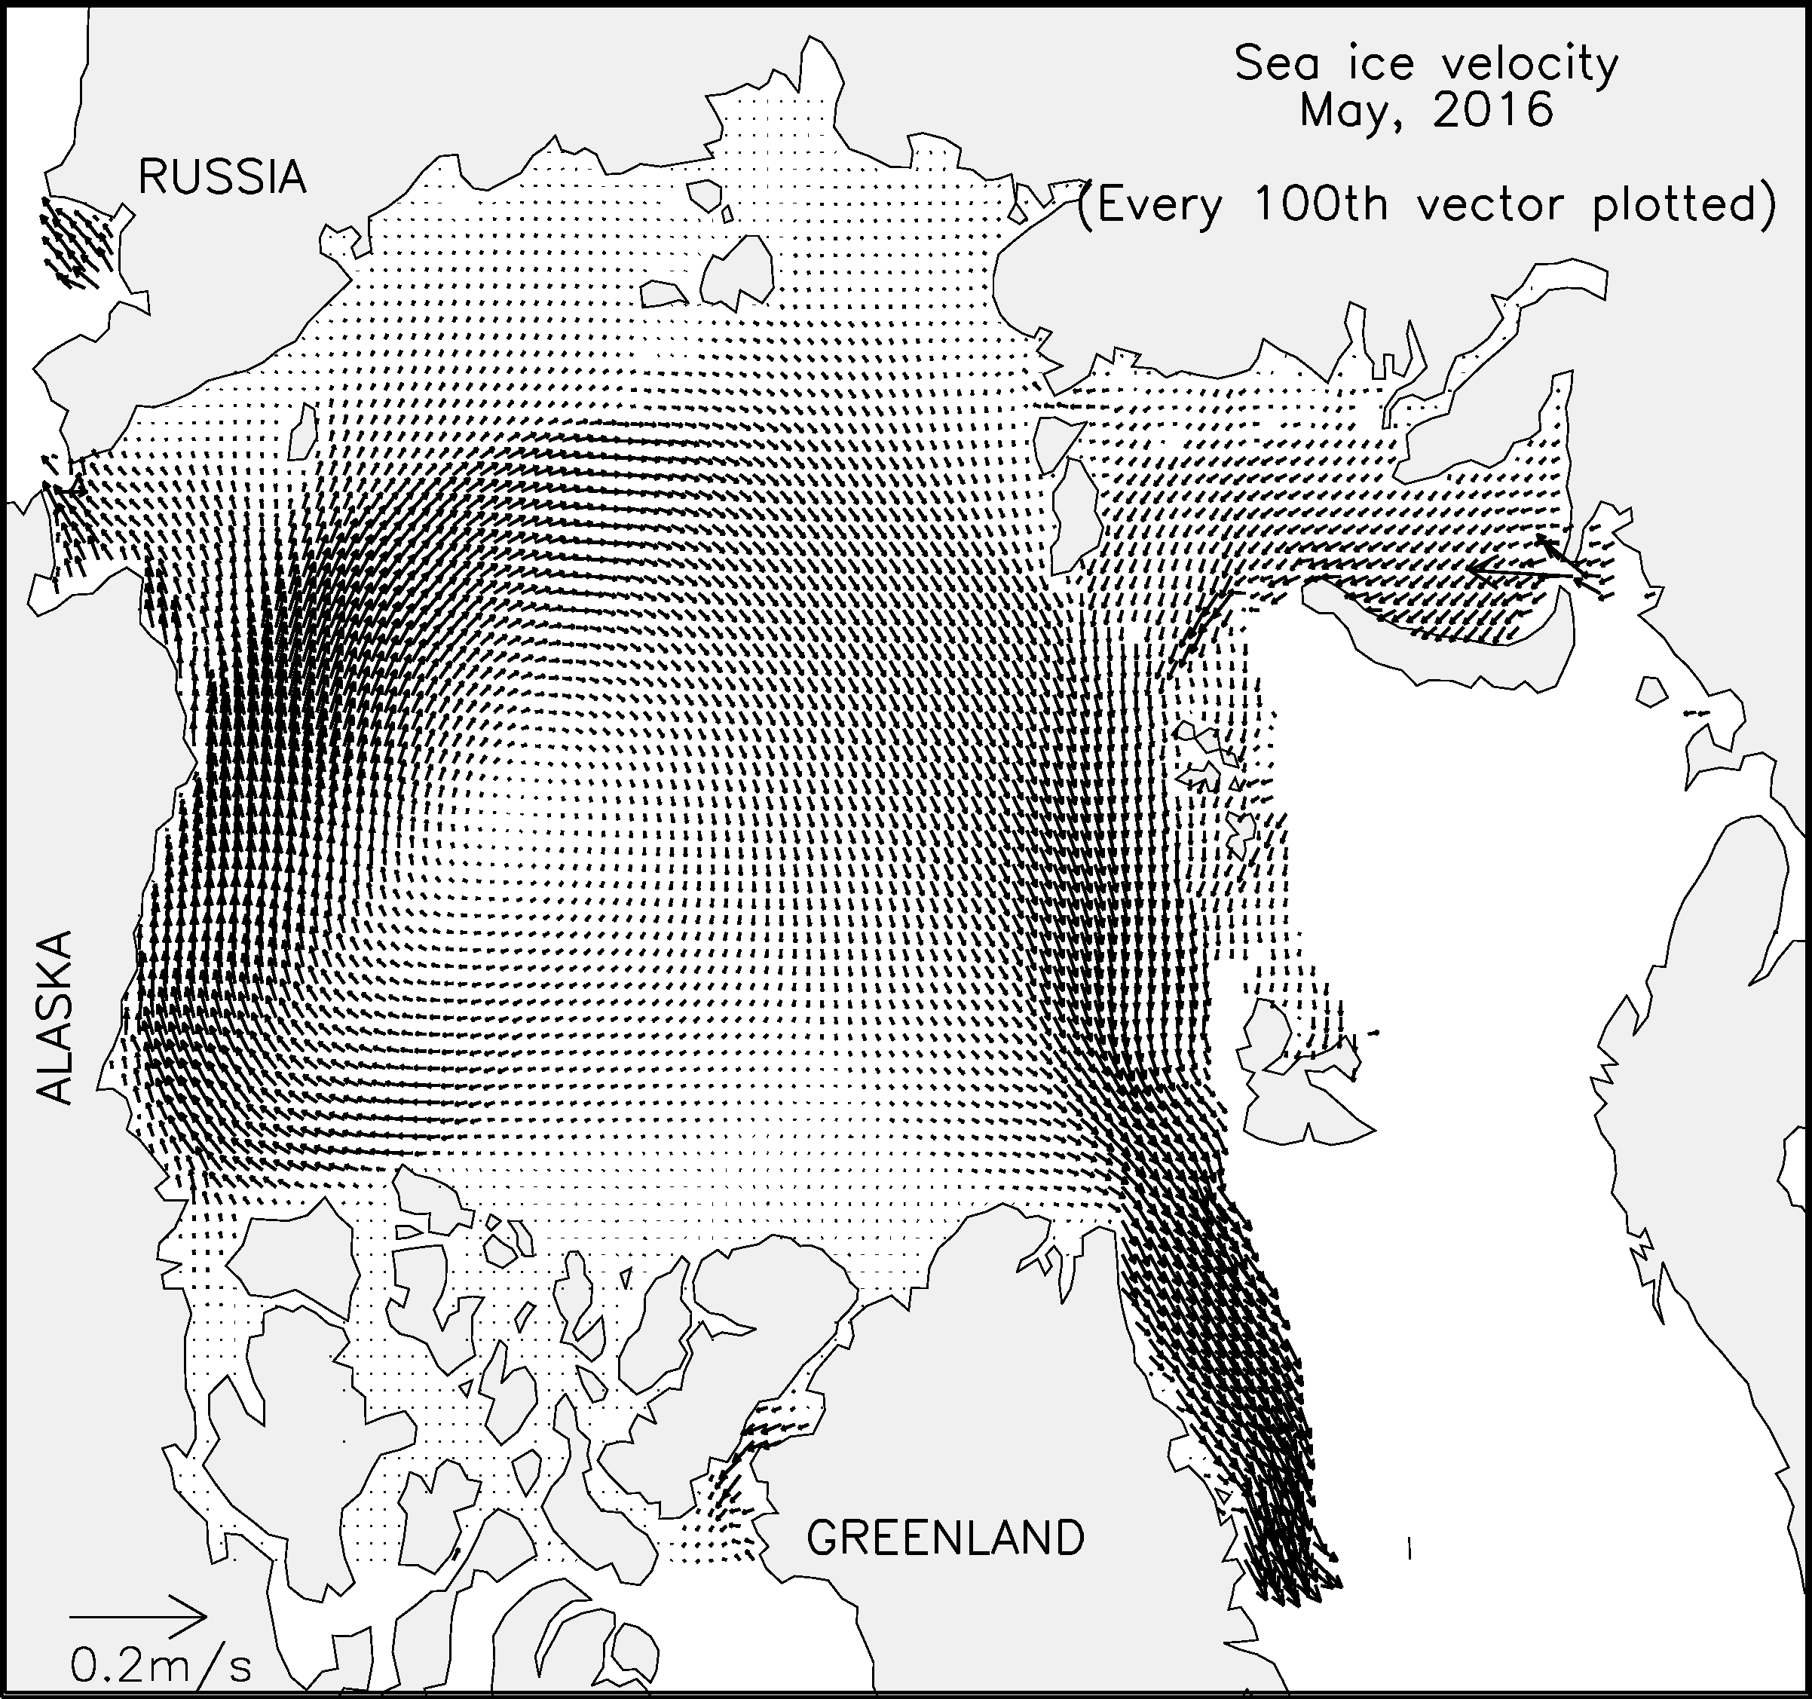
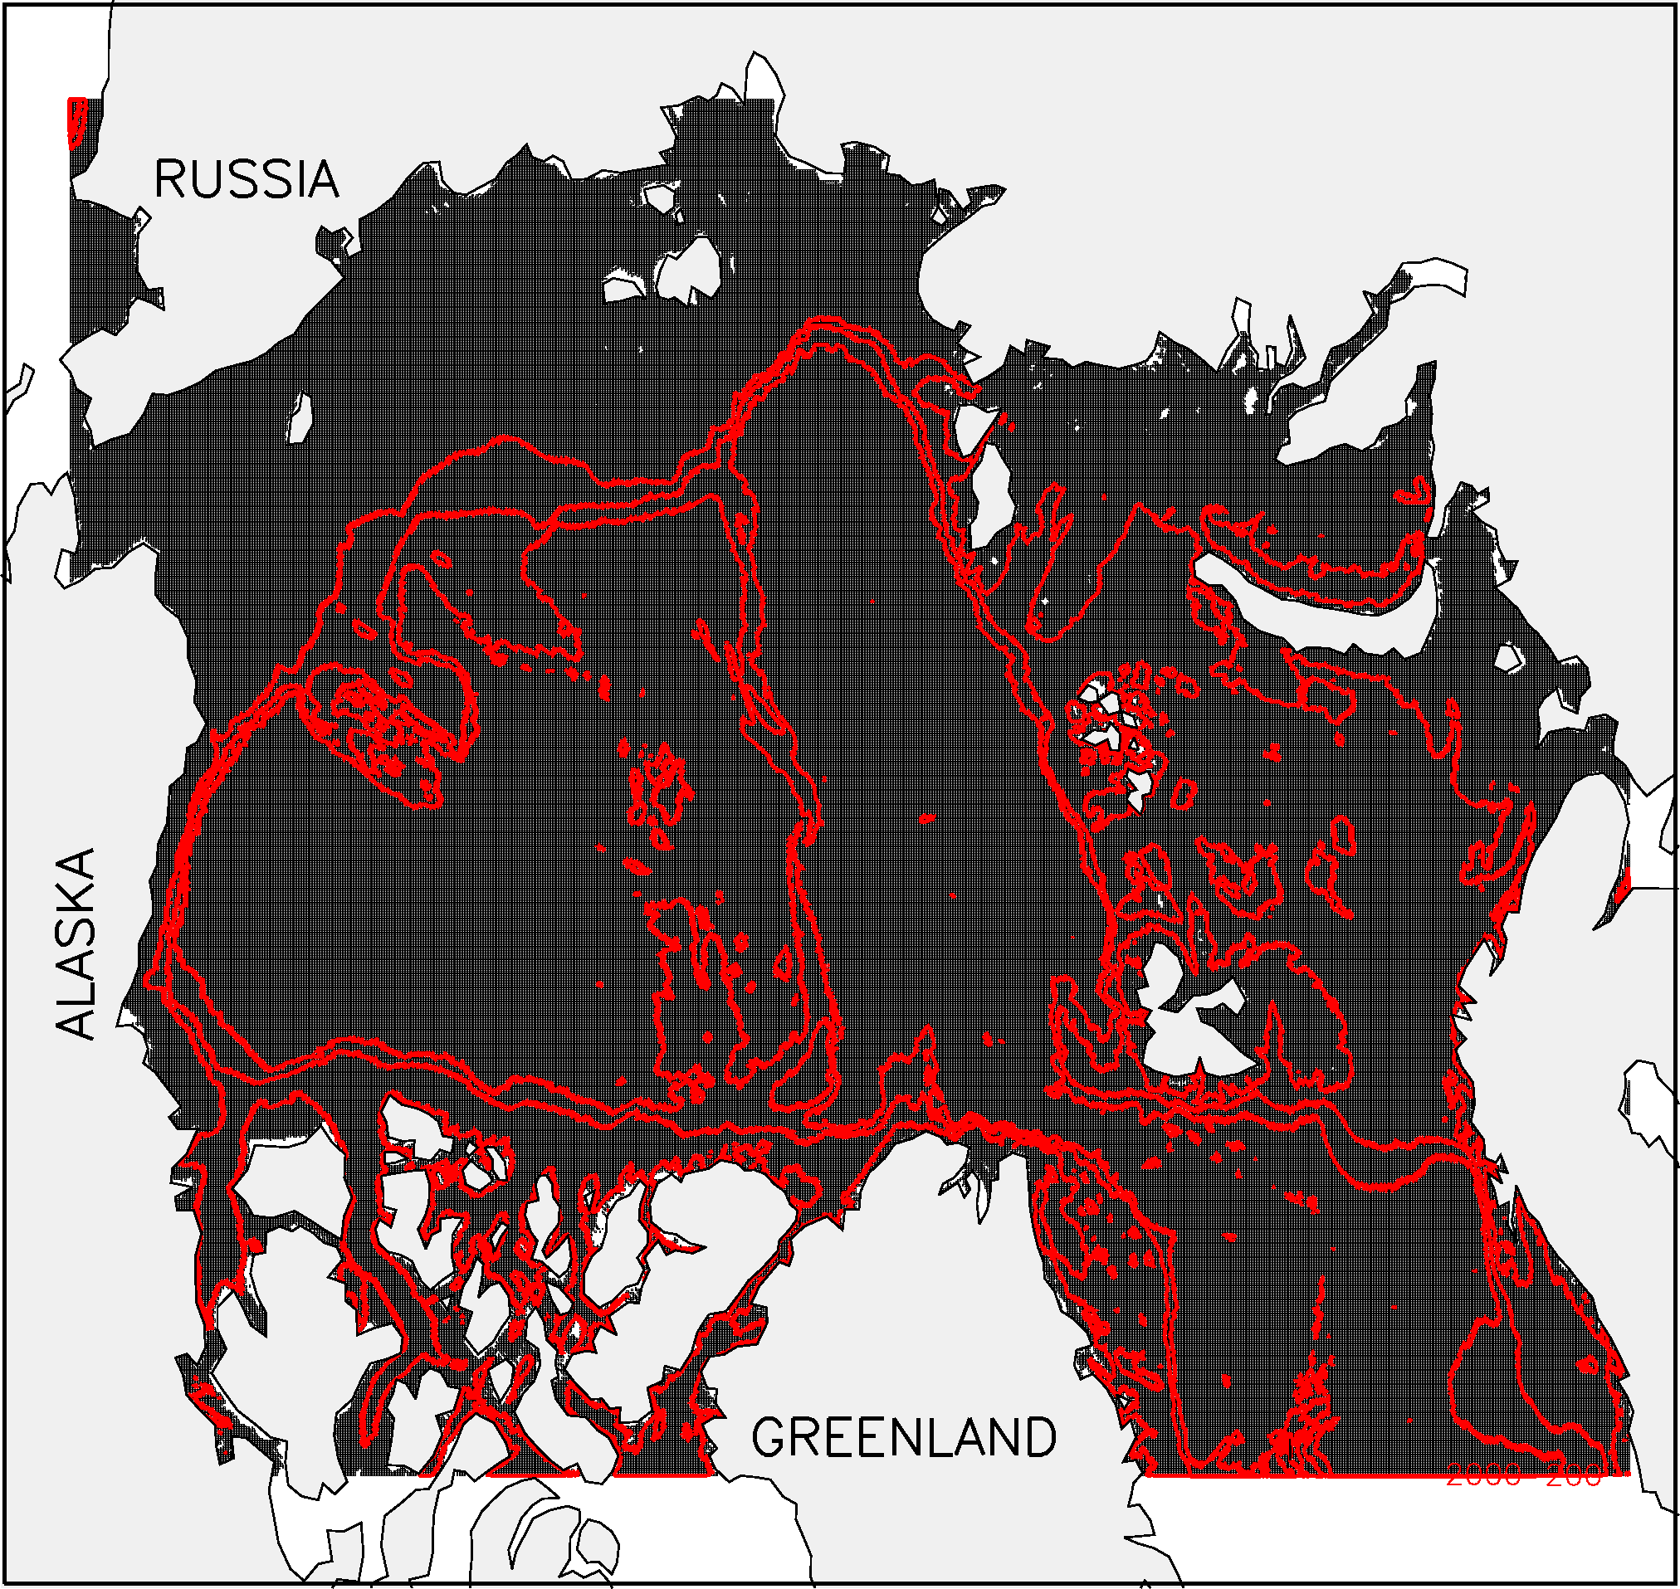
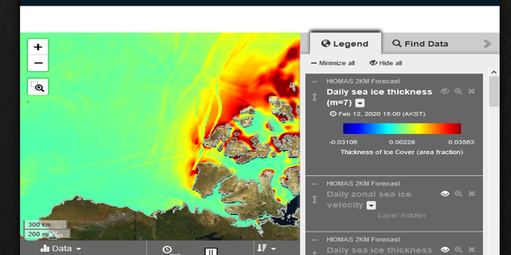
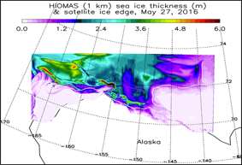
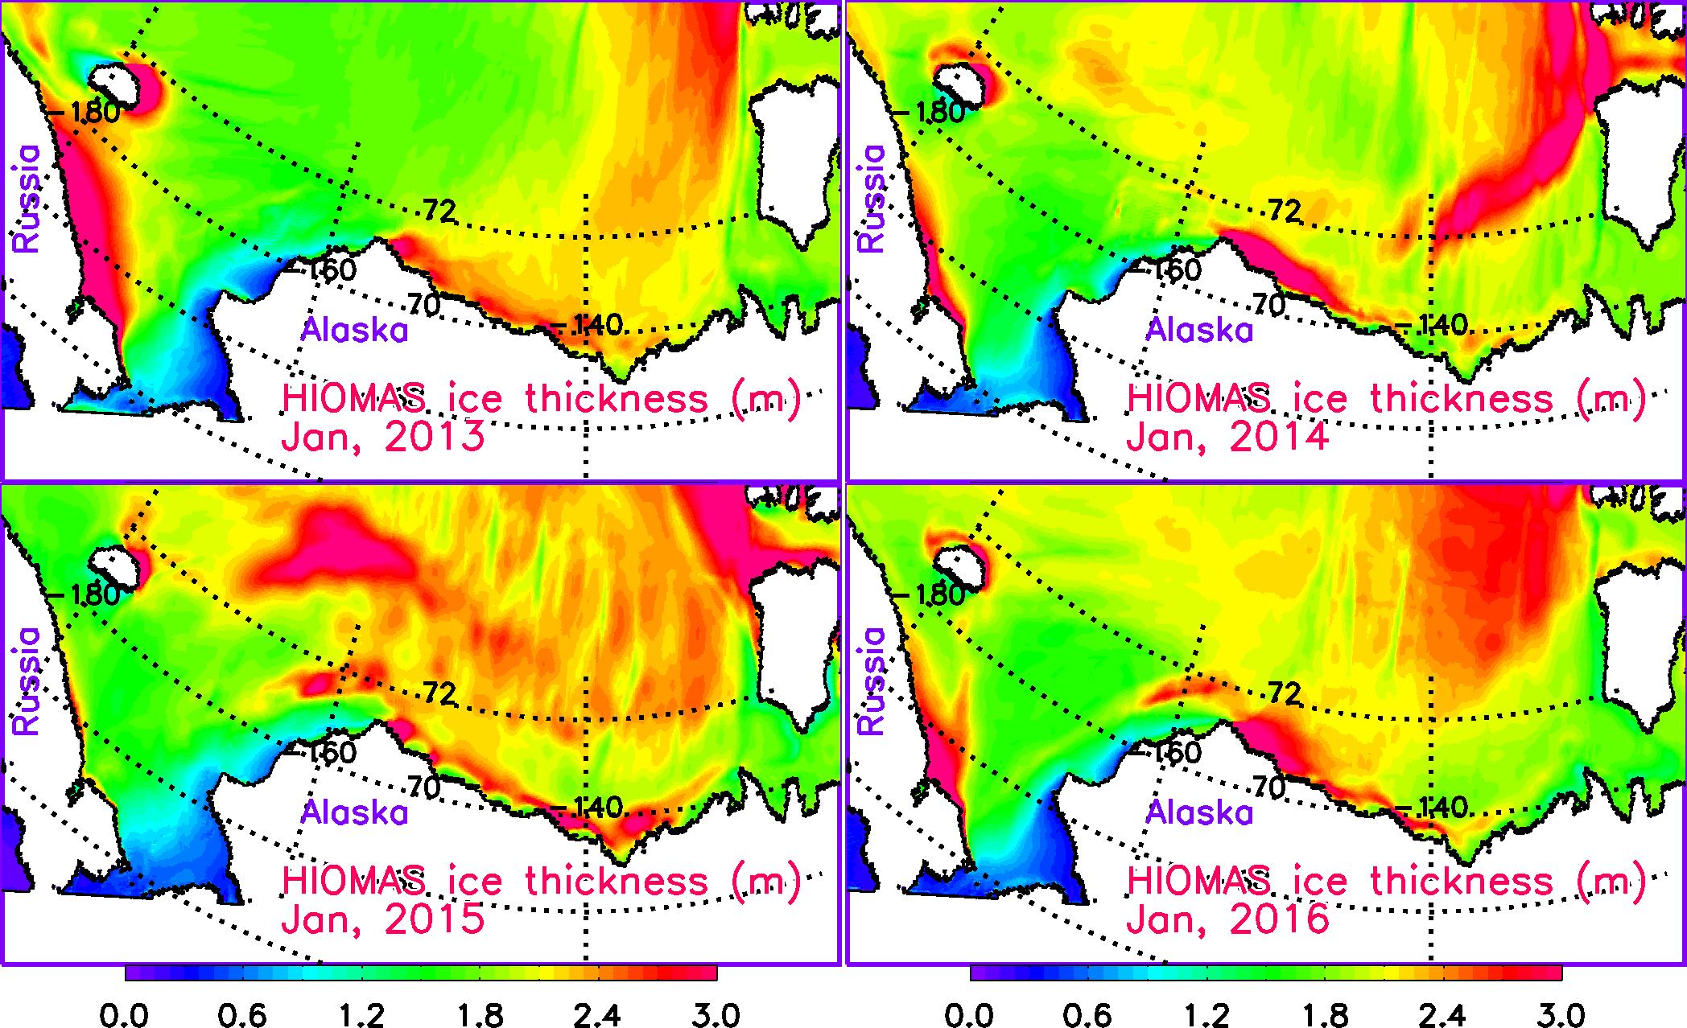
High resolution Modeling of Arctic Sea Ice and Currents
ADAC Program Year 8 Annual Meeting
HIOMAS (High-resolution Ice-Ocean Modeling and Assimilation System)
A forecast system that can distribute the forecast data to the Coast Guard and other Arctic stakeholders.
Developed 3 versions of HIOMAS with 6, 4 and 2 km horizontal resolutions. Now 24 Factors of detail!
Assimilate satellite sea ice concentration in HIOMAS hindcast to improve initial conditions for forecast.
Calibrated and validated HIOMAS hindcast using sea ice observations; no excessive ice thickness buildup in areas such as the Beaufort Sea.
Conducted (near) real-time hindcast and daily to seasonal forecast of Arctic sea ice and currents.
Prototype 1 KM resolution version for the US. EEZ for Bering, Chukchi and Beaufort Seas
Publishing…Bi-weekly, 7 Day Hindcast, 30 Day Forecast
2 km resolution Pan Arctic HIOMAS
Ice ridges above and month to month planning below…
1 km resolution HIOMAS…US Arctic EEZ
Transition: Completed to AOOS and Axiom Data Sciences as destination to publish to NOAA, NWS, & US National Ice Center

Slide 18
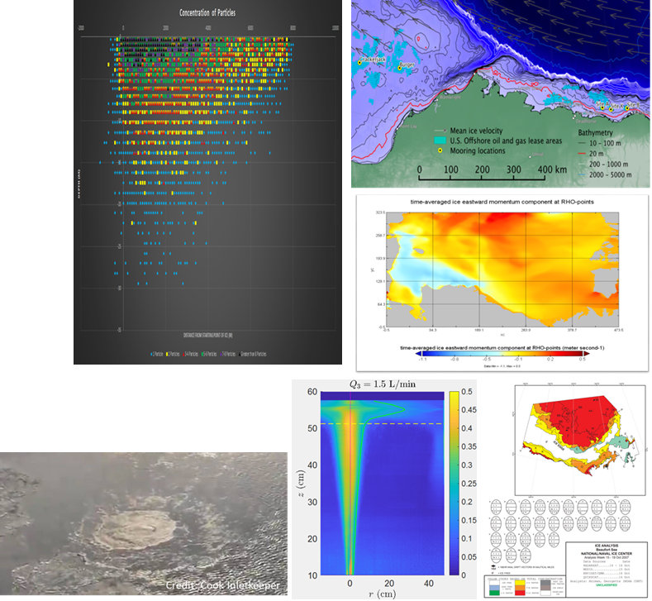
Arctic Oil Spill Modeling (AOSM)
ADAC Program Year 8 Annual Meeting
Project assists U.S. Coast Guard and the NOAA Office of Response and Restoration with the development of an Arctic-capable oil spill model that can be leveraged via NOAA’s General NOAA Operational Model Environment (GNOME).
Worked with NOAA to develop a new variable within GNOME: under-ice storage capacity.
Ice storage capacity has been estimated at several locations in the Chukchi and Beaufort Seas, based on ice draft data.
Provided 3 D model support for LRAUV.
Improving integration of TAMOC with GNOME to include all oil fate processes.
Training with NOAA staff to use TAMOC and AOSC algorithms within GNOME.
Capable of “On-demand” support (such as Cook Inlet Methane Leak).
Transition: Completed to NOAA’s GNOME.

Slide 19
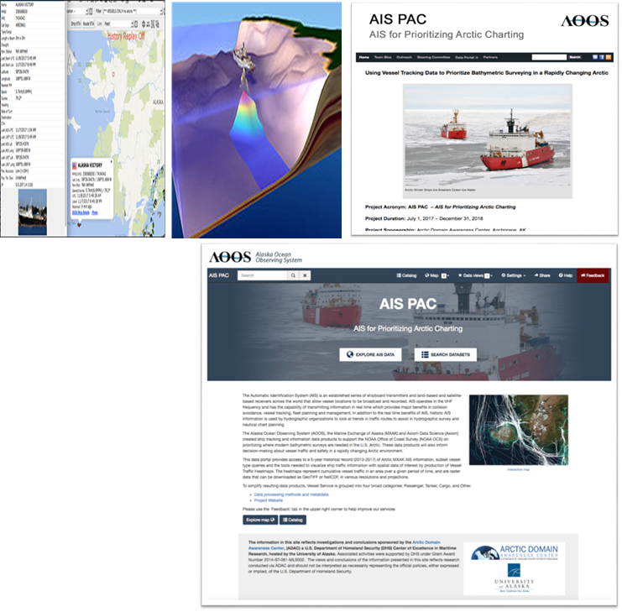
Using Vessel Tracking Data to Prioritize Bathymetric Surveying
ADAC Program Year 8 Annual Meeting
Project creates products that inform decision-making about vessel traffic and vessel safety in a rapidly changing Arctic environment.
The research effort is develop the capability to reduce execution time for handling and analyzing exceptionally large collections of Automated Information System (AIS) vessel tracking data.
A large data analytics effort.
Gridded files provide the extracted AIS information needed for decision makers and stakeholders in the U.S. Arctic area.
Transition: Completed: A set of knowledge products useful for USCG and NOAA to apply to survey/mapping efforts for Alaska (including Arctic Alaska). Now being leveraged for NOAA Summer Bathymetric Surveys
AOOS AIS-PAC Completed Project Webpage: http://aoos.org/ais-4-bathy/

Slide 20
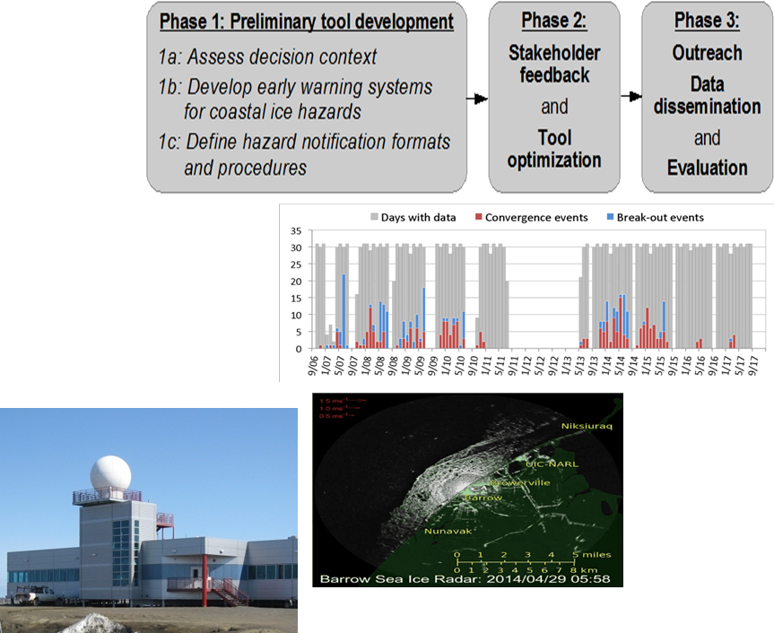
Crisis Response Sea-Ice and Weather Forecasting tools
ADAC Program Year 8 Annual Meeting
Research project strives to improve USCG and other DHS Arctic maritime operator situational awareness and crisis response by enhancing support for planning and emergency response to meteorological and environmental marine hazards in the Arctic.
Literature Reviews and interviews with a host of marine operators.
Identification of hazardous ice events using coastal radars:
  Ice Convergence,
  Landfast ice breakout, and
  Anomalous ice motion.
Transition: Researchers developed decision support tools, grounded in stakeholder interactions, to support weather and sea ice-sensitive decision making. Developed a prototype with software and hardware in the Barrow region. Provided prototype observations provided via AOOS to NOAA/NWS Observations. Established working prototype at Barrow Arctic Research Facility in conjunction with UAF and Sandia National Labs

Slide 21
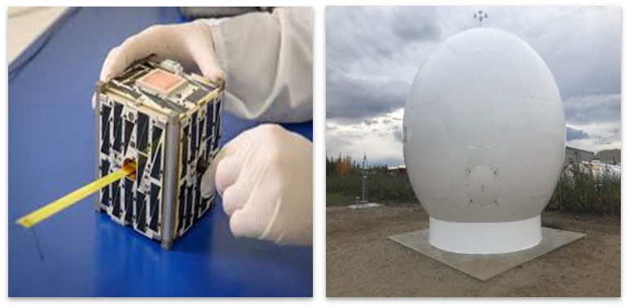
Exploring Enhancements to Arctic Communications and Domain Awareness using the ASF CubeSat Antenna Farm Experiment (CAFE)
ADAC Program Year 8 Annual Meeting
Project is direct USCG award, that partners ADAC and University of Alaska Fairbanks’ Alaska Satellite Facility to conduct cube satellite research in support of USCG Arctic Communications shortfall research via a Mobile CubeSat Command and Control (MC3) antenna system and radome at the Alaska Satellite Facility. Research will increase USCG knowledge on Arctic communications and viability of Cube satellites to improve maritime communication in Bering, Chukchi and Beaufort Seas.
Transition: Depends on directions from HQ DHS S&T.
4 Dec 2019: Satellites Kodiak and Yukon deployed on Polar Low Earth Orbit...Kodiak functioning in accordance with plan, but while Yukon initially functioned, communications was lost shortly following first contact.
However, experiment is considered a success.

Slide 22
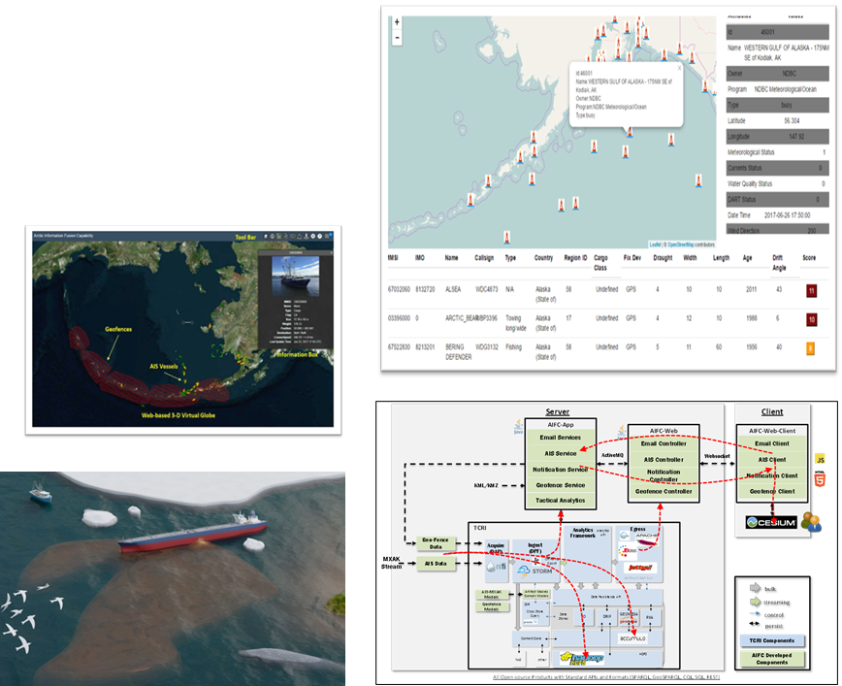
Arctic Information Fusion Capability
ADAC Program Year 8 Annual Meeting
The Arctic Information Fusion Capability (AIFC) project supported operational decision makers in the maritime domain ranging from operational commanders, to tactical operators, to community-based observers.
AIFC fused together a wide array of near real-time, high resolution data sources into a cohesive and easy to understand interface.
The project took in satellite imagery, environmental models, local sensors, web-based communications, and appropriate social networking feeds to gain domain awareness in support of operational decision making by responders in the field.

Slide 23
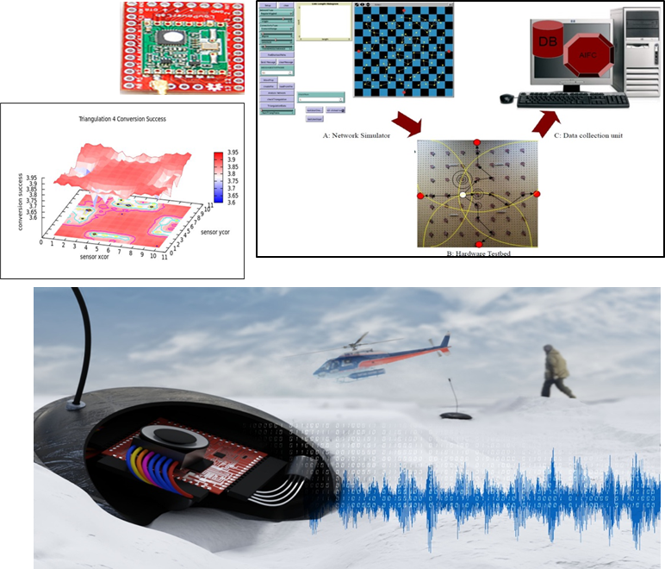
Low-Cost Wireless Remote Sensors for Arctic Monitoring and Lifecycle Assessment
ADAC Program Year 8 Annual Meeting
The Arctic is hard to constantly monitor. In order to resolve this problem, low-cost wireless sensors were developed to detect an input event, analyze detected events, and communicate that event data to other sensors in the network.
These inexpensive, self-organizing network devices reliably computed and communicated detected human, animal, and environmental events. By utilizing a variety of sensors, it was possible to detect sounds, vibrations, radio and cellphone signals, location, and more based upon the needs of each sensor.
When implemented, the project would have provided a quick method to deploy and monitor an Arctic region. Potential uses were events such as ice breakup, environmental events, model validation, vehicle detection in regions of concern, or even assisting with the safety monitoring of personnel and equipment during training exercises.

Slide 24
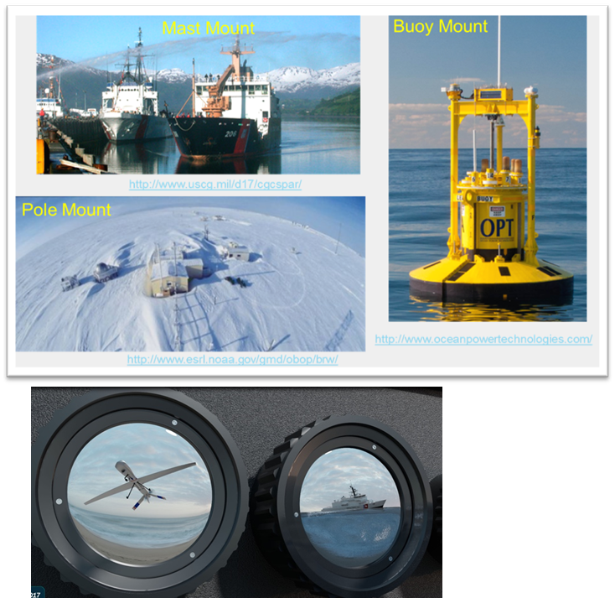
Smart-Cam Computational Photometer
ADAC Program Year 8 Annual Meeting
The goal of this project was to construct a proof-of-concept visible two channel (optional visible + long wave infrared multispectral) camera proof of concept to be tested at the Port of Anchorage. The proof-of-concept was to be constructed using all off-the-shelf hardware components and used to form a baseline of comparison for the longer-term Computational Photometer (“Smart-Cam”), for a longer-term goal of the research, for Arctic operations with drop-in-place multi-spectral and stereo vision cameras.
From the proof-of-concept it was expected that challenges of long-term battery operations, drop-in-place packaging for Arctic environments, and power efficiency and methods to recharge can be better understood for follow-on phases.
Potential uses were for oil detection under ice in an AUV and tracking and detecting vessels, animals, and people in fog and ice environments typical of the Arctic.

Slide 25
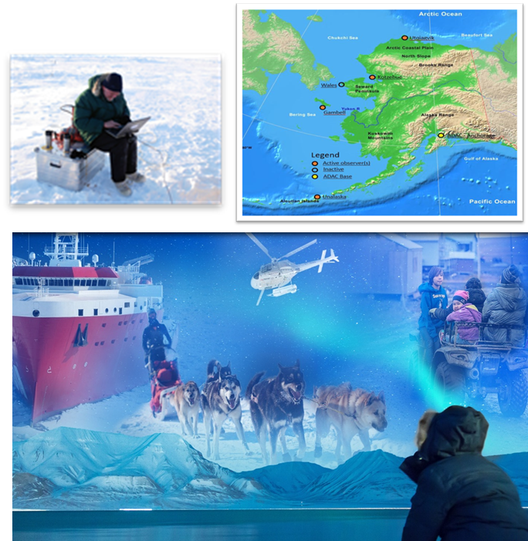
Community Based Observer Networks for Situational Awareness
ADAC Program Year 8 Annual Meeting
This project established a community-based observing network and system (CBONS) to acquire fine scale, local data on a range of variables critical to USCG operations. It was developed to enhance the Coast Guard’s ability to successfully respond to Arctic-related Incidents of National Significance (Arctic IoNS).
Variables were associated with environmental change, subsistence activities/habitats and vessel transits. CBONS data was then used to enhance the preparedness of communities on the ground, leading to increased effectiveness of USCG in the Arctic and reduced long-term costs.
The project also generated community maps consisting of areas critical to culture and subsistence, allowing the Coast Guard to operate in ways that protect livelihoods and traditional lifeways. Finally, CBONS data are potentially useful to enhance the precision of data from other Arctic Observing Networks (AON) by placing them in situational contexts.

Slide 26
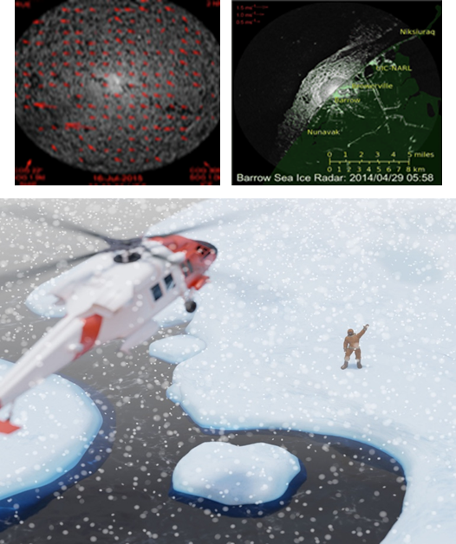
Identifying, Tracking and Communicated Sea-Ice Hazards in an Integrated Framework
ADAC Program Year 8 Annual Meeting
Increasing shipping and offshore activity together with emerging climate change-related threats to coastal and marine infrastructure related to traffic have greatly increased threats to environmental security in the maritime Arctic. In order to minimize and manage risks, hazards need identification and tracking. This project focuses on those hazards associated with ice in the ocean such as entrapment of vessels; structural damage to vessels and infrastructure; and risks to personnel and assets due to detachment of landfast ice.
During an Arctic emergency response, assets need safe and effective deployment in regions that are often remote and challenging. Involvement of local first responders will be a critical part of any Arctic response. Therefore, responders need a framework at the local scale to enhance and inform Arctic MDA and emergency response by identifying, tracking and communicating key environmental hazards in ice covered extreme maritime environment.
Predicting the real-time ice velocity from Utqiaġvik (formally Barrow), Alaska will improve capabilities for ice hazard monitoring. As the northernmost point in the North American mainland, Point Barrow is often the last location along the Alaska coastline to open up to navigation and therefore represents a potential chokepoint for maritime operations in the U.S. Arctic. Making real-time data available to analysts will improve the ability of decision makers to assess hazards posed by sea ice in this location. Additionally, the project team demonstrated that the technology developed to track ice motion is transferrable to ship-based platform, where it is potentially useful to provide tactical information about ice conditions to crew.

Slide 27
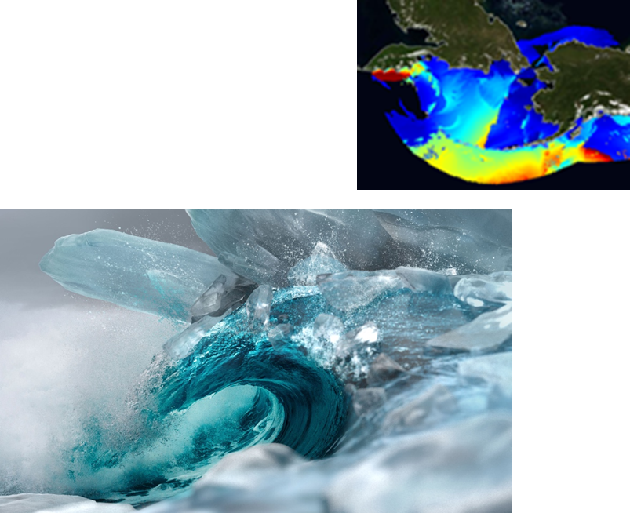
Real-Time Storm Surge and Coastal Flooding Forecasting for Western Alaska
ADAC Program Year 8 Annual Meeting
University of Alaska Anchorage (UAA) developed a high-resolution storm surge model for the Yukon-Kuskoswim Delta area to provide high-resolution forecasts of storm surge and coastal flooding for vulnerable coastal communities in Western Alaska.
In addition to flooding, the model also predicts thirty-one associated ecological impacts, assuming different sea level rise scenarios. The storm surge modeling was conducted with Delft3D software.
The ocean boundary of the storm surge model was “forced” by real-time and forecasted water level data generated by National Weather Service’s Extra Tropical (ET)-Storm Surge model. In addition, we developed a hindcasting storm surge model for the Norton Sound.
The model was forced on its ocean boundary by output from a course grid ADCIRC storm surge model developed by the U.S. Army Corps of Engineers.
The Delft3D and SWAN models were used for the storm surge and wave modeling, respectively. The ocean boundary of the SWAN wave model came from nowcasts and forecasts from NOAA’s Wavewatch III wave model. The model wave calibrated and validated using nearshore water level data and using satellite observations of inundation extent.

Slide 28
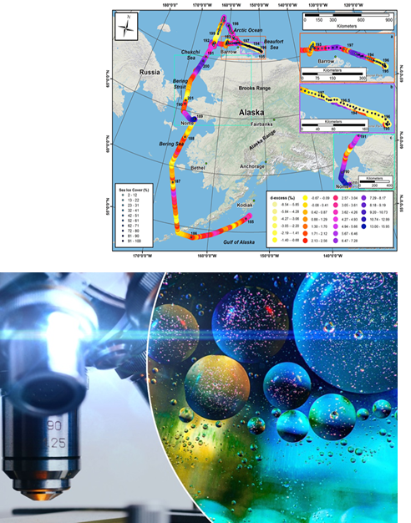
Monitoring Intentional and Unintentional Catastrophic Events: Detecting sea ice and oil spills through measurement of the H2O and C isotope geochemistry in winds.
ADAC Program Year 8 Annual Meeting
Winds of the maritime environment have been continuously monitored as a means of detecting sea ice conditions; vessel emissions and oil spills against a natural background of marine boundary-layer atmospheric chemistry. Research measured water vapor isotopic attributes each second (averaging over 5 min) while transiting from the Gulf of Alaska to the Beaufort Sea on the USCG Healy as well as placed-based station measurements at the Port of Anchorage. Our primary aim is to provide ship or vessel captains real-time data of sea ice conditions (open water, light sea ice, heavy sea ice and total sea ice coverage) that will be displayed at the helm of vessels that are fitted with the detection systems as well as making sea ice conditions estimates available from shore/platform-based systems via a link at the ADAC web site.
Simultaneously, team detected unusual petroleum events in the marine environment, developed a visualization model that will display petroleum (carbon) in the environment across a range of categories (green=ambient/background conditions; yellow=changing conditions; red=extreme changes-i.e. vessel or aircraft emission plume or oil spill plum in the direct vicinity). Our primary findings are that sea ice conditions are reliably reflected in situ on ships as is the presence of aircraft emissions. Shore based systems (Port of ANC) are more complicated and sea ice coverage detection is less reliable, in our case do to the distance (~100 yards) of the measurement system from the ocean.
Winds and seawater of the maritime environment are to be continuously monitored as a means of detecting sea ice conditions, vessel emissions and oil spills against a natural background of marine boundary-layer atmospheric
chemistry. This was accomplished by measuring these attributes while transiting from the Gulf of Alaska to the N
end of the Chukchi Sea (78ºN) on the USCG Healy as well as placed-based stations in Cook Inlet/Port of Anchorage.

Slide 29
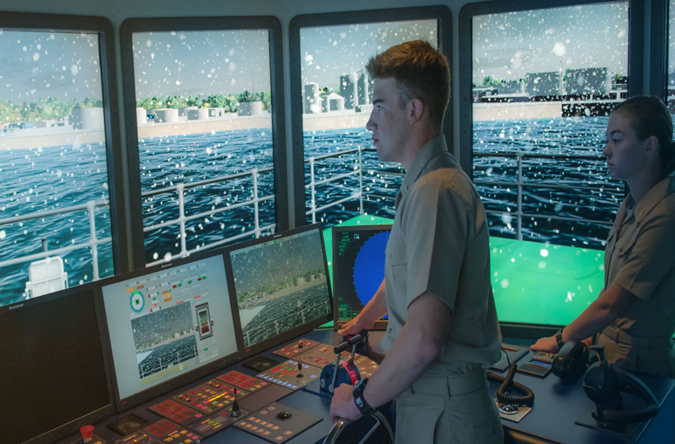
Mariner Ice Navigation Courseware for IMO Polar Code
ADAC Program Year 8 Annual Meeting
This project saw the development of an advanced ice navigation course required by the Polar Code for all masters and chief mates operating in polar waters.
Through this project, a class and simulator was created to teach the basic and advanced ice navigation courses satisfy these requirements for U.S. mariners. Upon completion of these courses, American ship’s officers will have met or exceeded all Standards for Training, Certification, and Watchkeeping (STCW) required by international maritime law.

Slide 30
Next Steps….

Slide 31
Next Steps….Research Ideas and White Papers
ADAC Program Year 8 Annual Meeting
Feasibility Study to assess how Enhanced Port Facilities in the Barrow Area could enhance USCG Operations
Small, scalable and sustainable power generation in support of operation at remote austere locations
GNSS GPS Reflectometry Systems as Remote Telemetered Tide Gauges
Remotely Deployed, Real-Time Ice Freeze-up Detection Buoy for National Weather Service Ince and Weather Forecasting Research
DHS Integrated Negotiation of Critical Infrastructure Threats and Engineering for Resilience (DHS INCITER)
Rapid Assessment of Disease-threats in the Arctic Region (RADAR)
A Rapid Deployment High Frequency Radar for Mapping Surface Currents for Remote Settings
Persistent Human Observation Capability for Offshore Surveillance (PHOCOS)

Slide 32
Ways to Fund ADAC for Project Support:
ADAC Program Year 8 Annual Meeting
Basic Order Agreement (BOA)
Broad Agency Announcement (BAA)
Contract
USACE Cooperative Agreement
CRADA
Grant
Direct Support

Slide 33
Questions?

